Slide 1
Solo Project: DND Character Database
John Brockman

Slide 2
Brief
Solo Project
CRUD Integration
Full Stack Application
Using OOP + Core Java Skills
Relational Database
Fully Tested

Slide 3
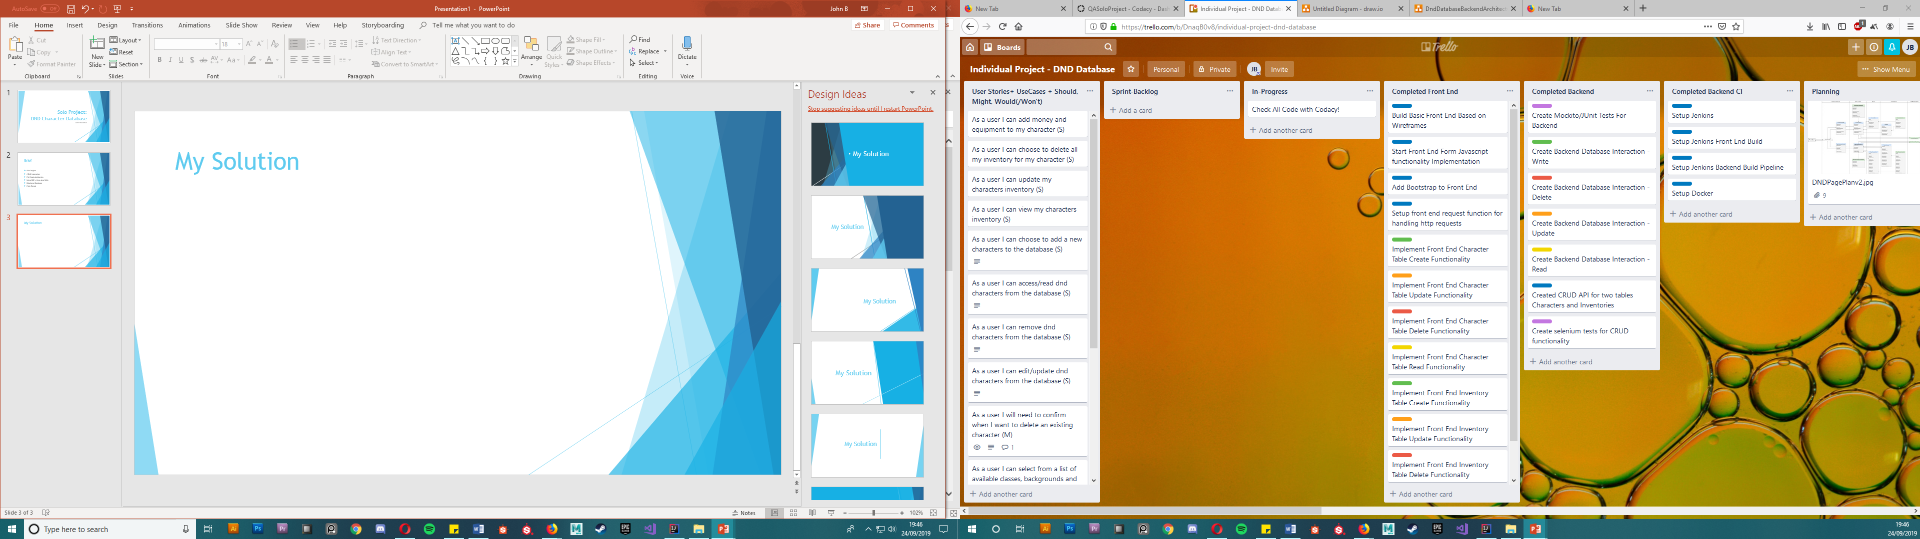
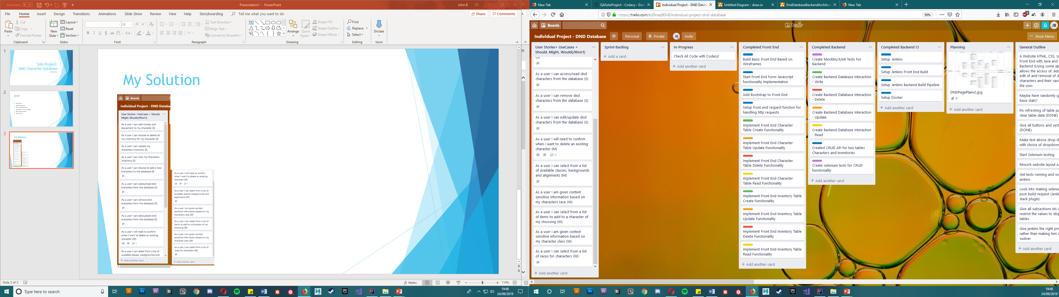
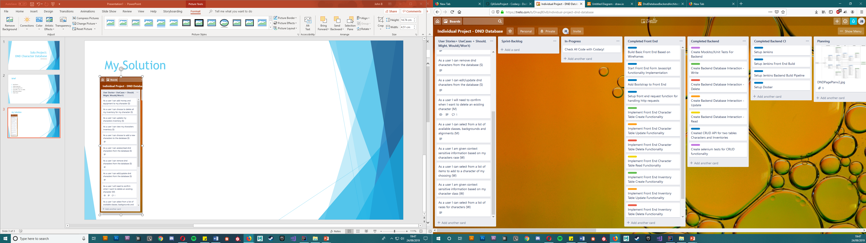
My Solution

Slide 4
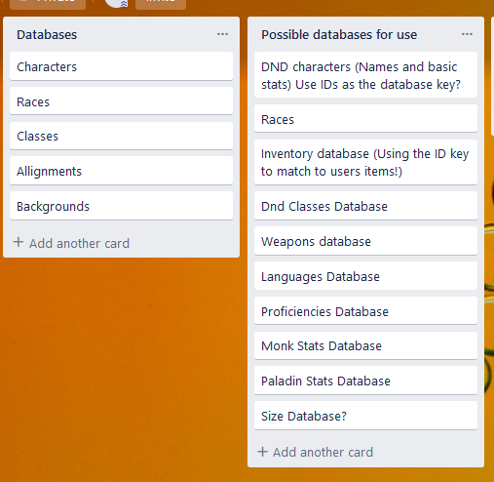
My solution

Slide 5
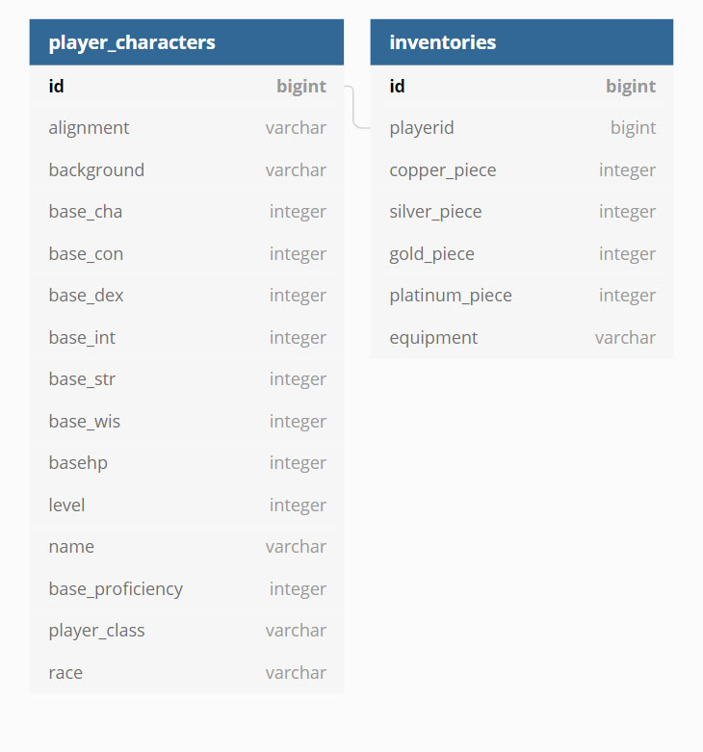
My Solution

Slide 6
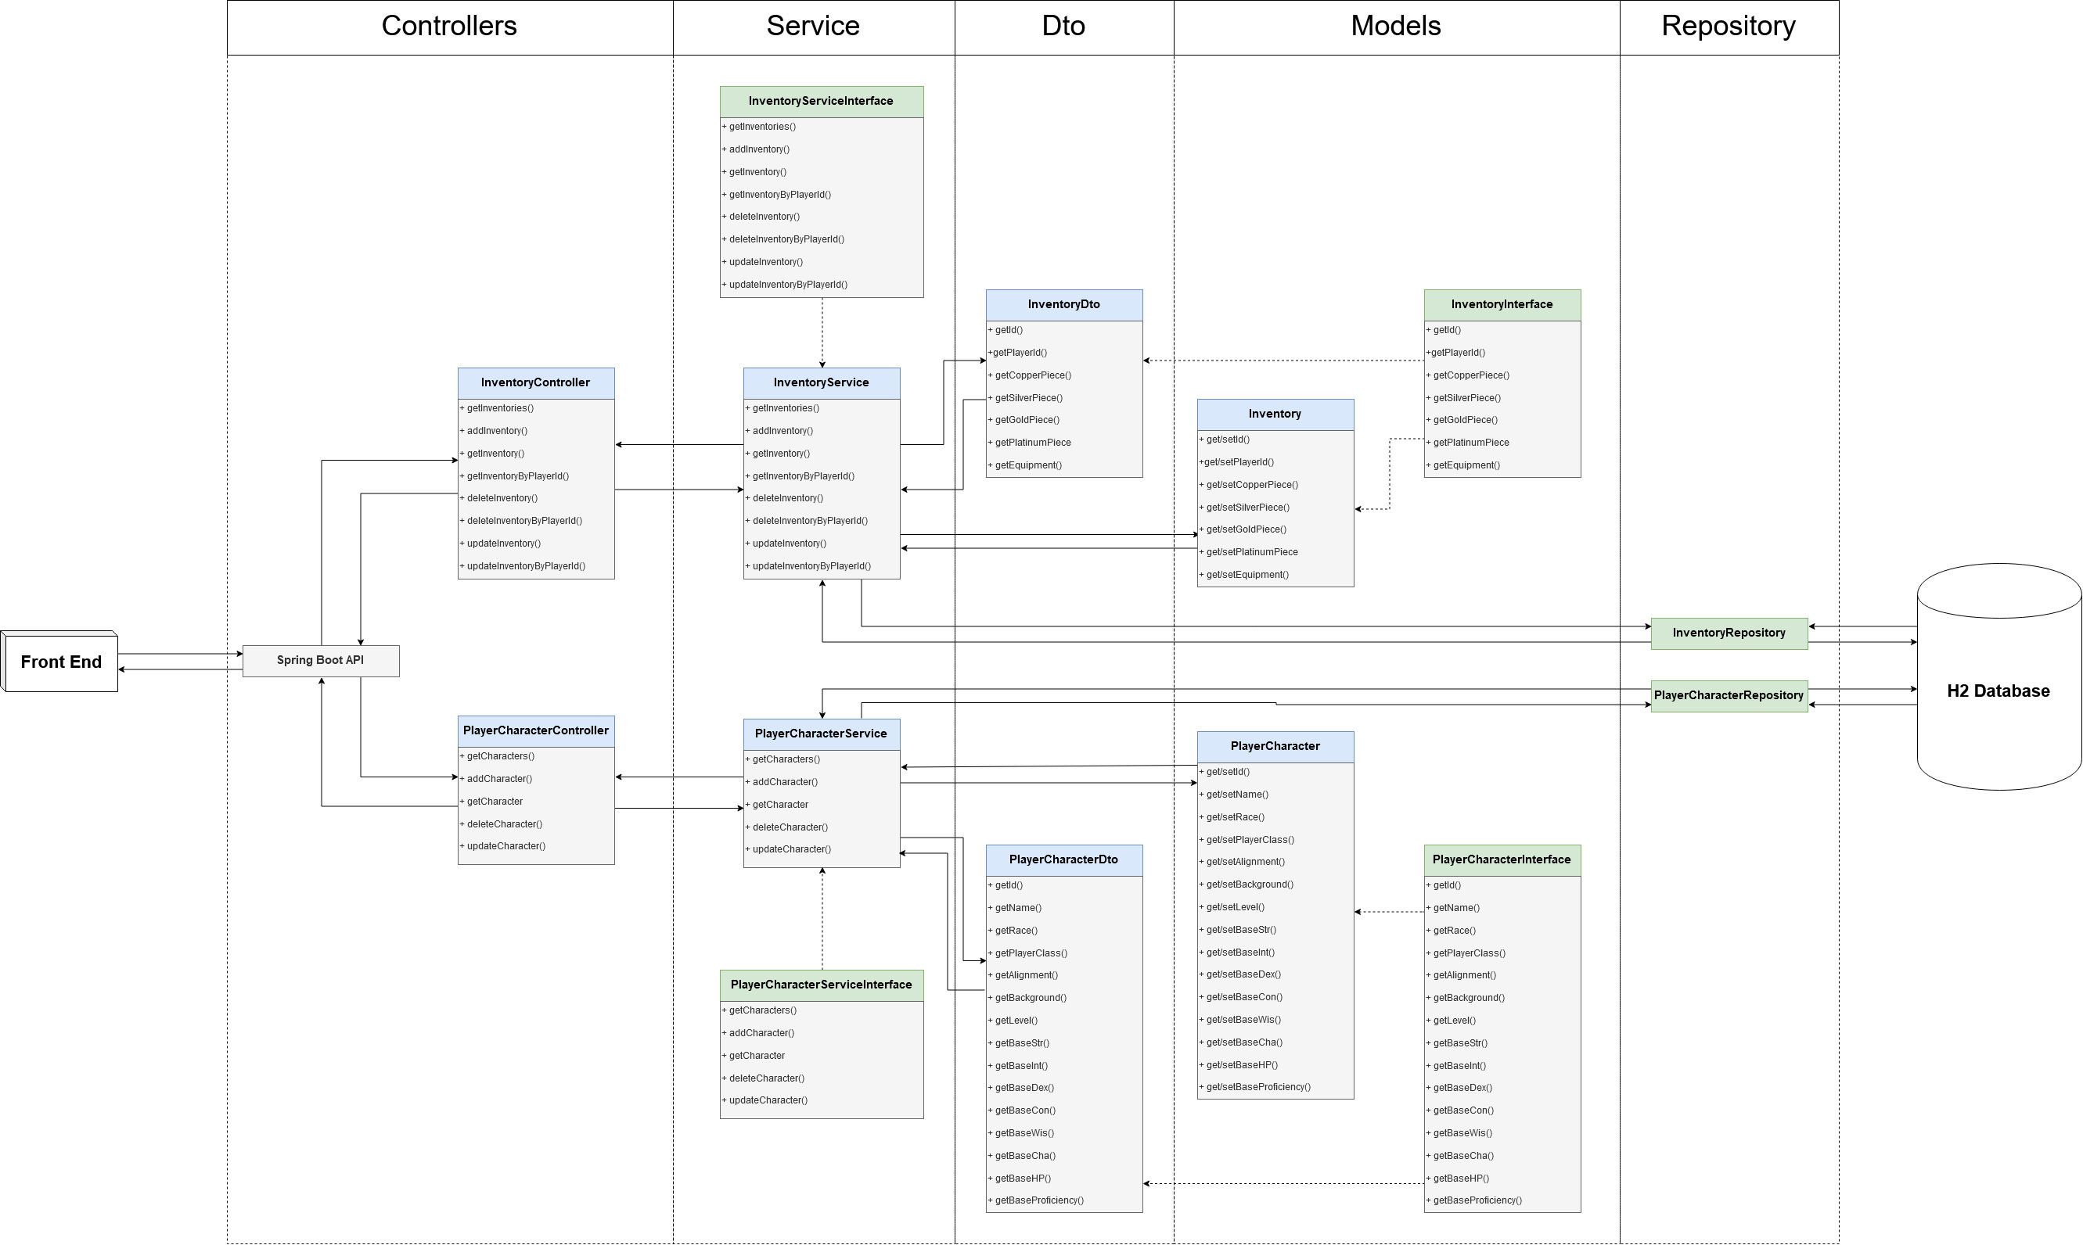
API Development

Slide 7
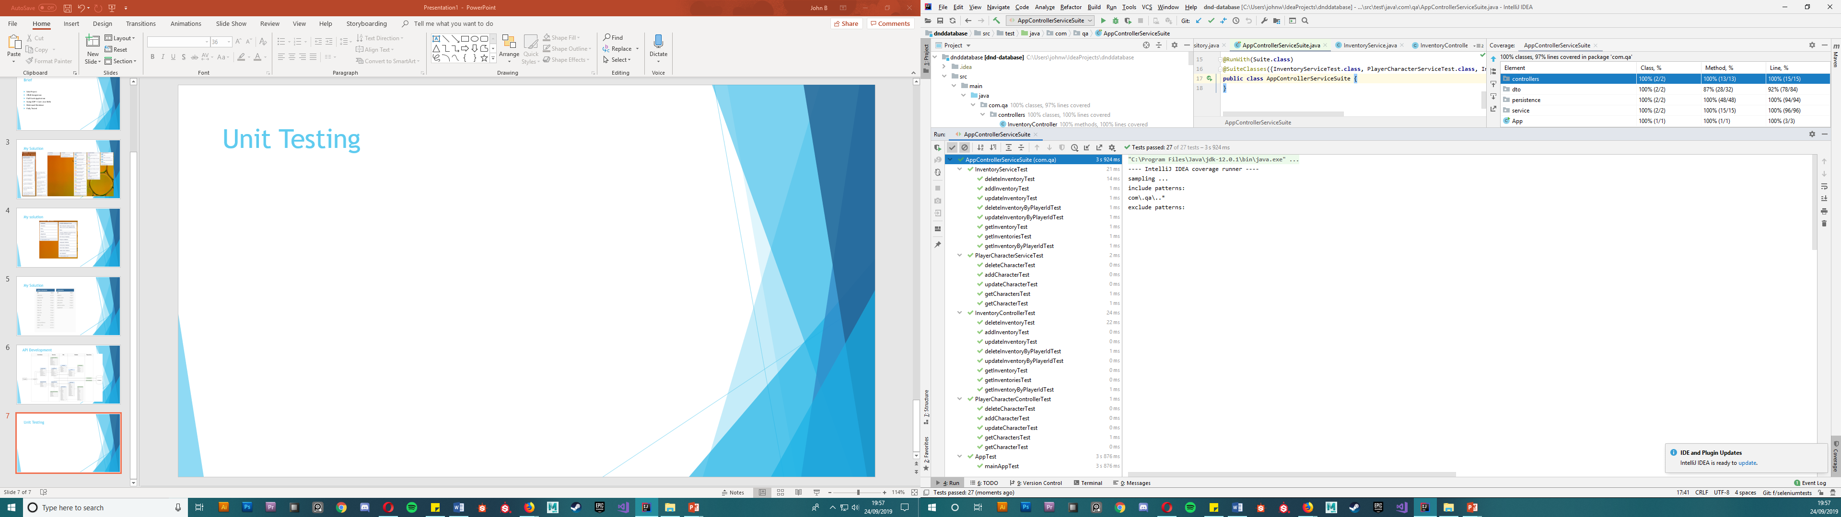
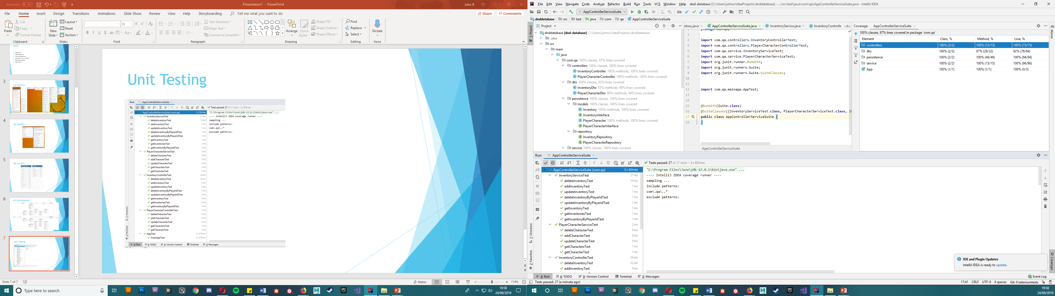
Unit Testing (Junit + Mockito)

Slide 8
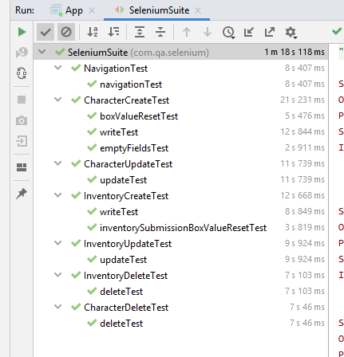
Selenium Tests

Slide 9
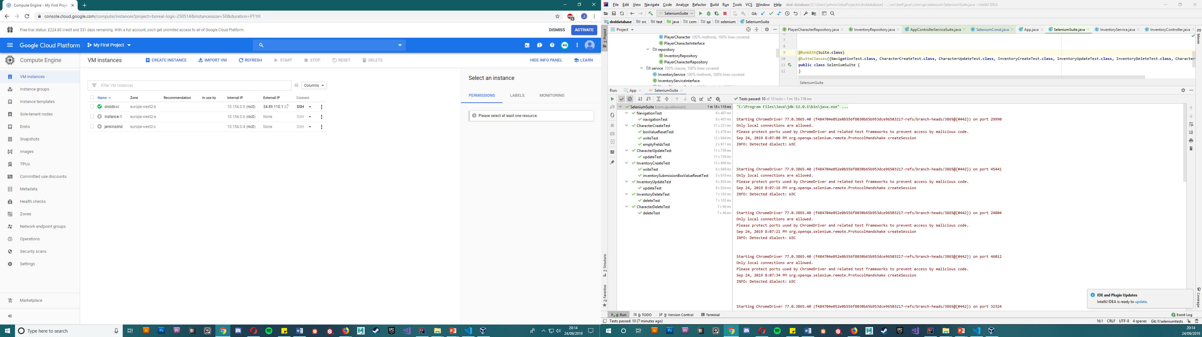
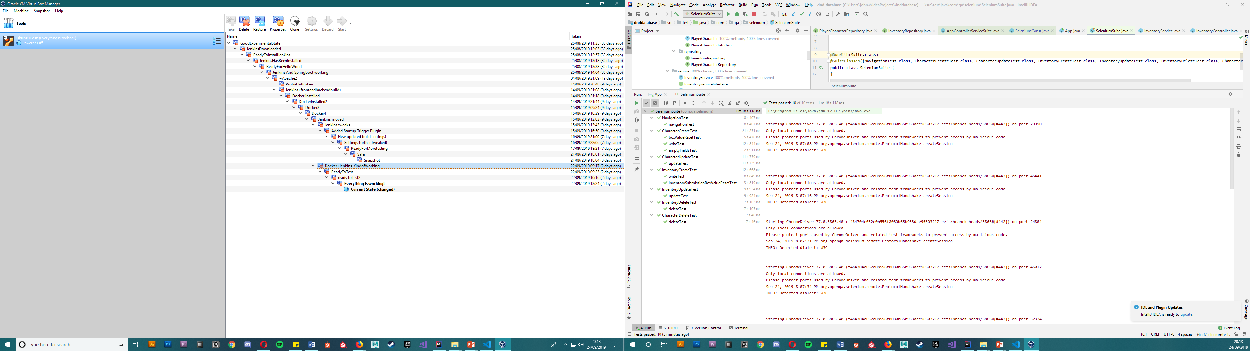
Jenkins CI Integration and GCP

Slide 10
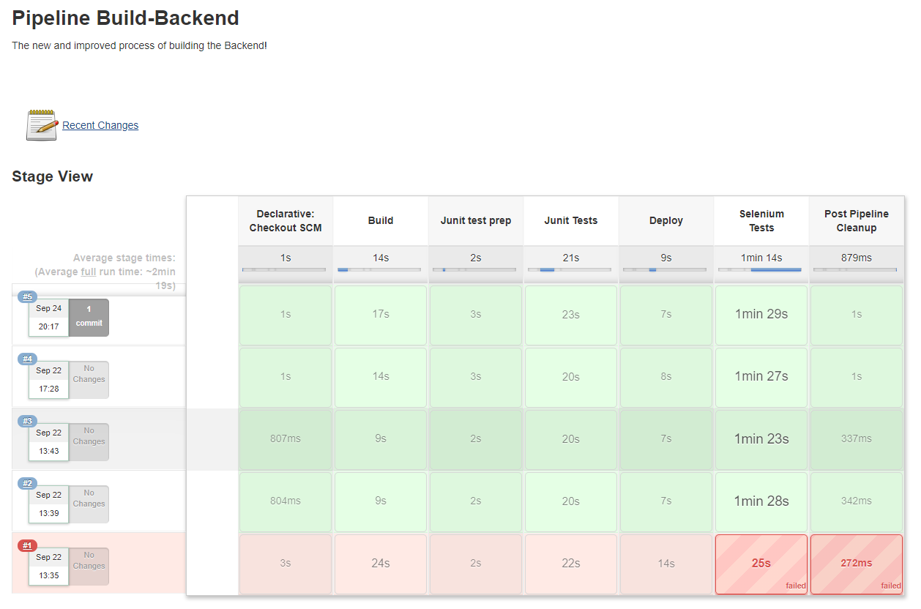
Jenkins CI Integration and GCP

Slide 11
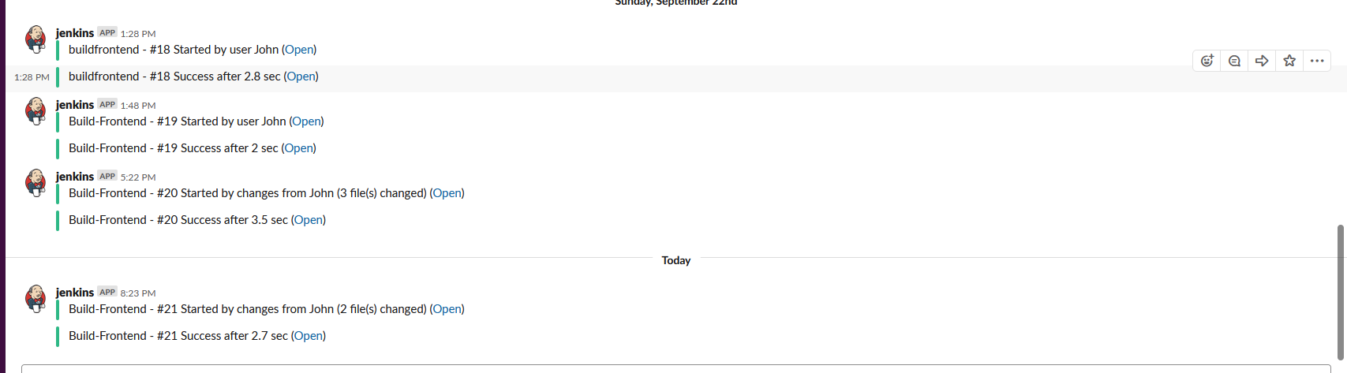
Jenkins CI Integration and GCP

Slide 12
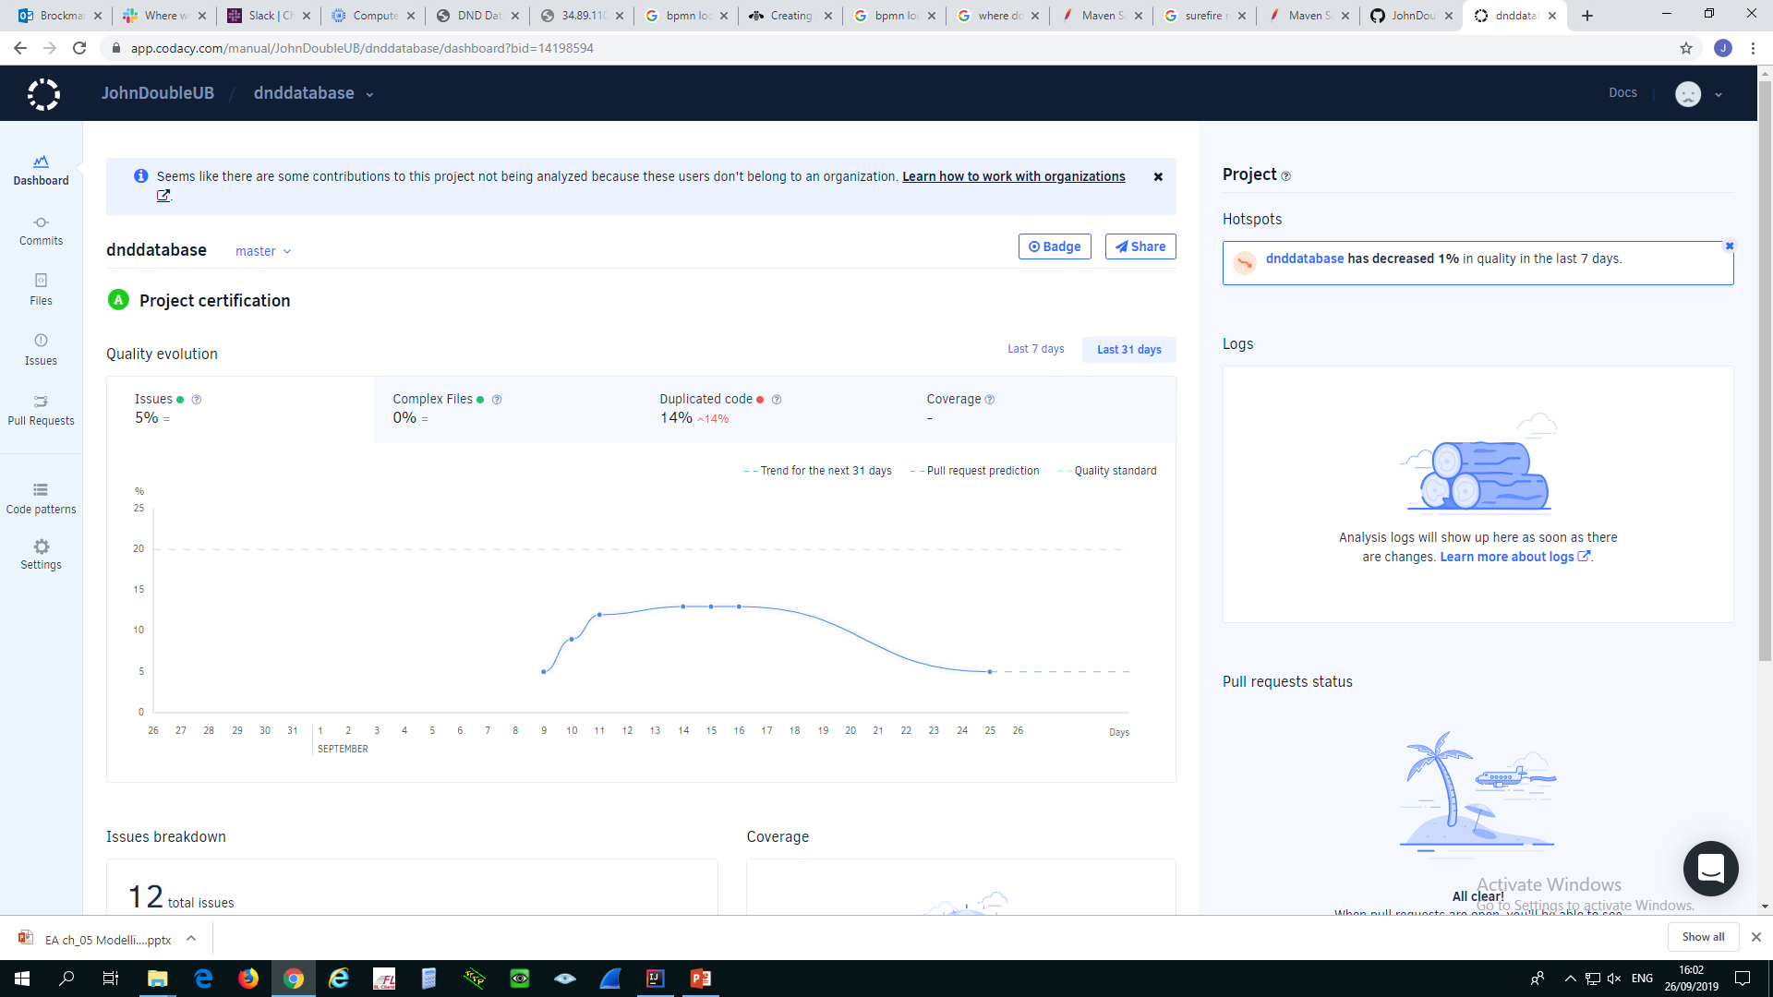
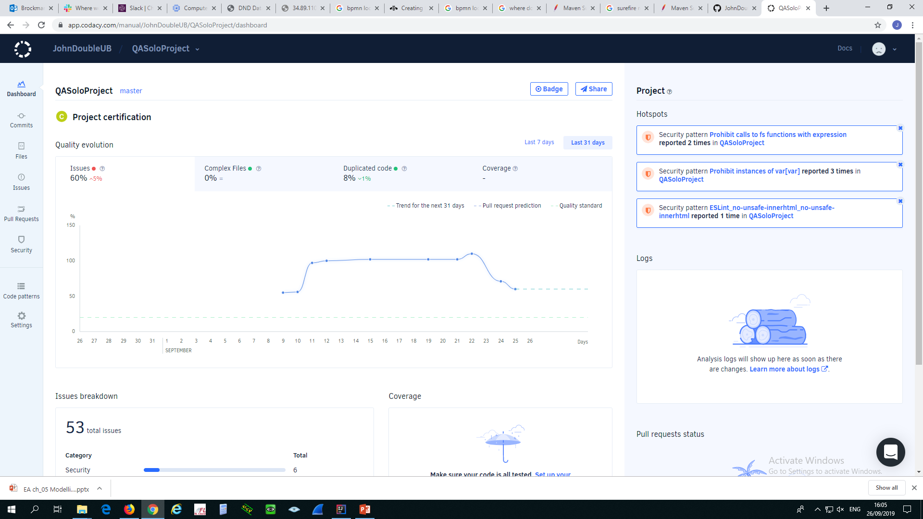
Code Quality Checking

Slide 13
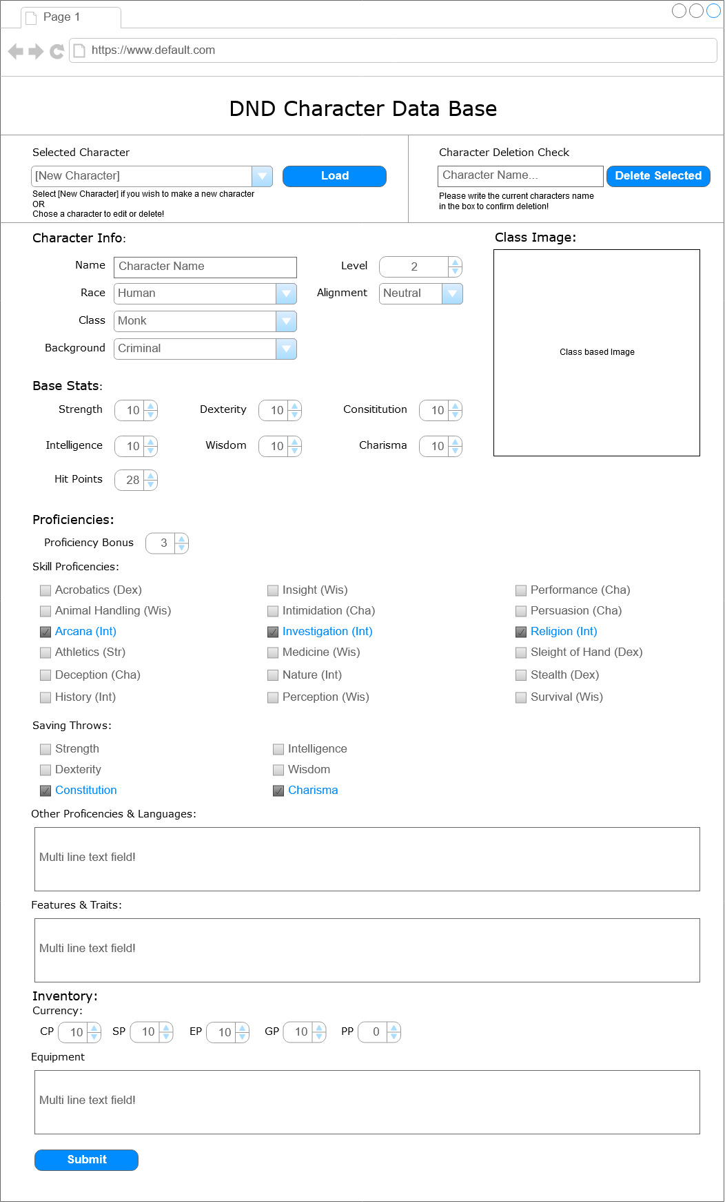
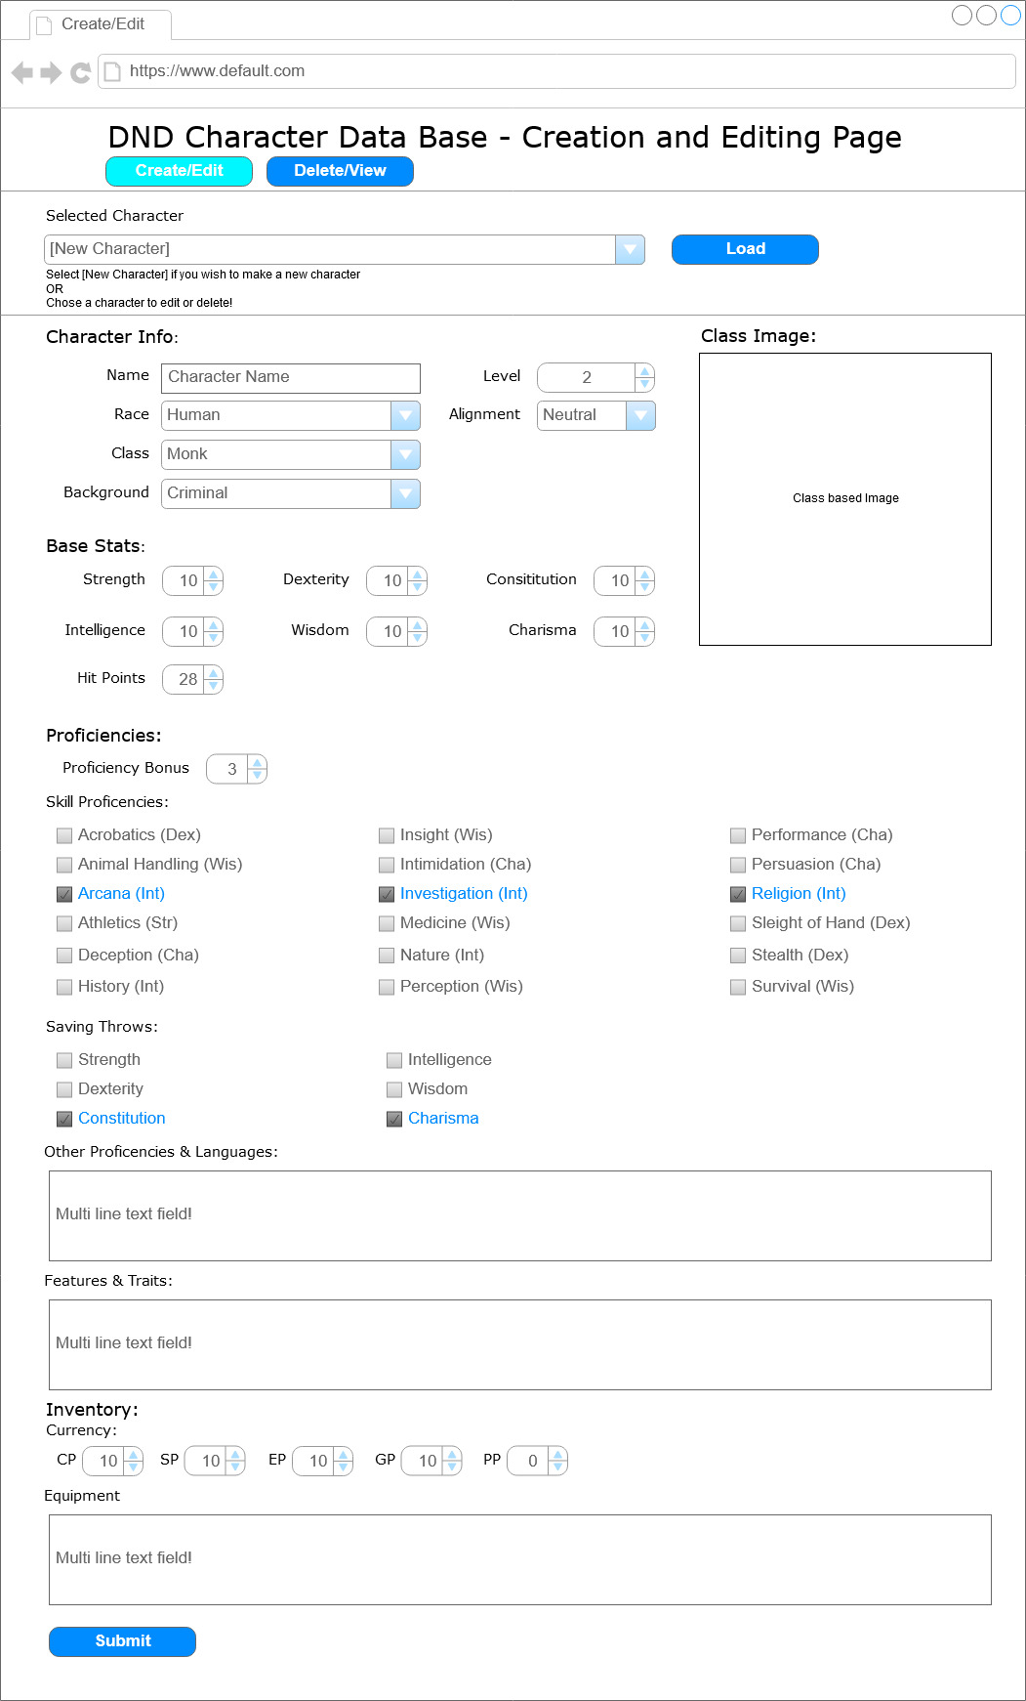
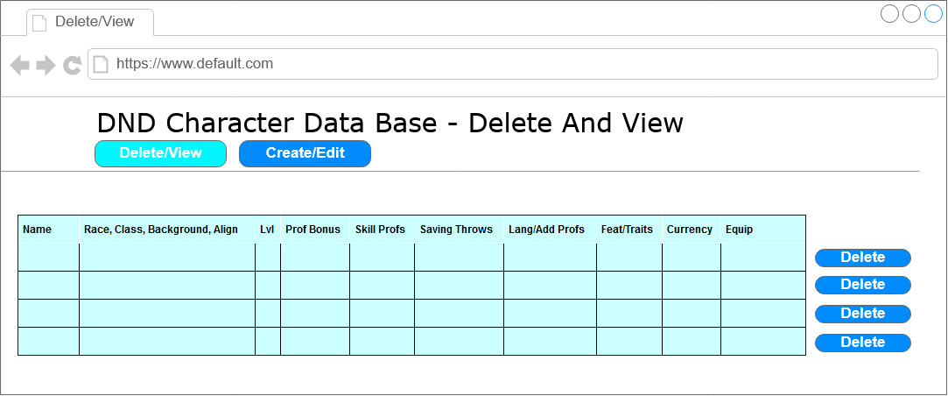
Front End - Initial Wireframes

Slide 14
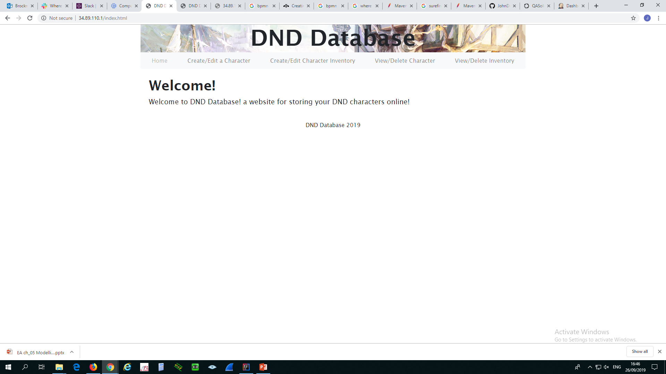
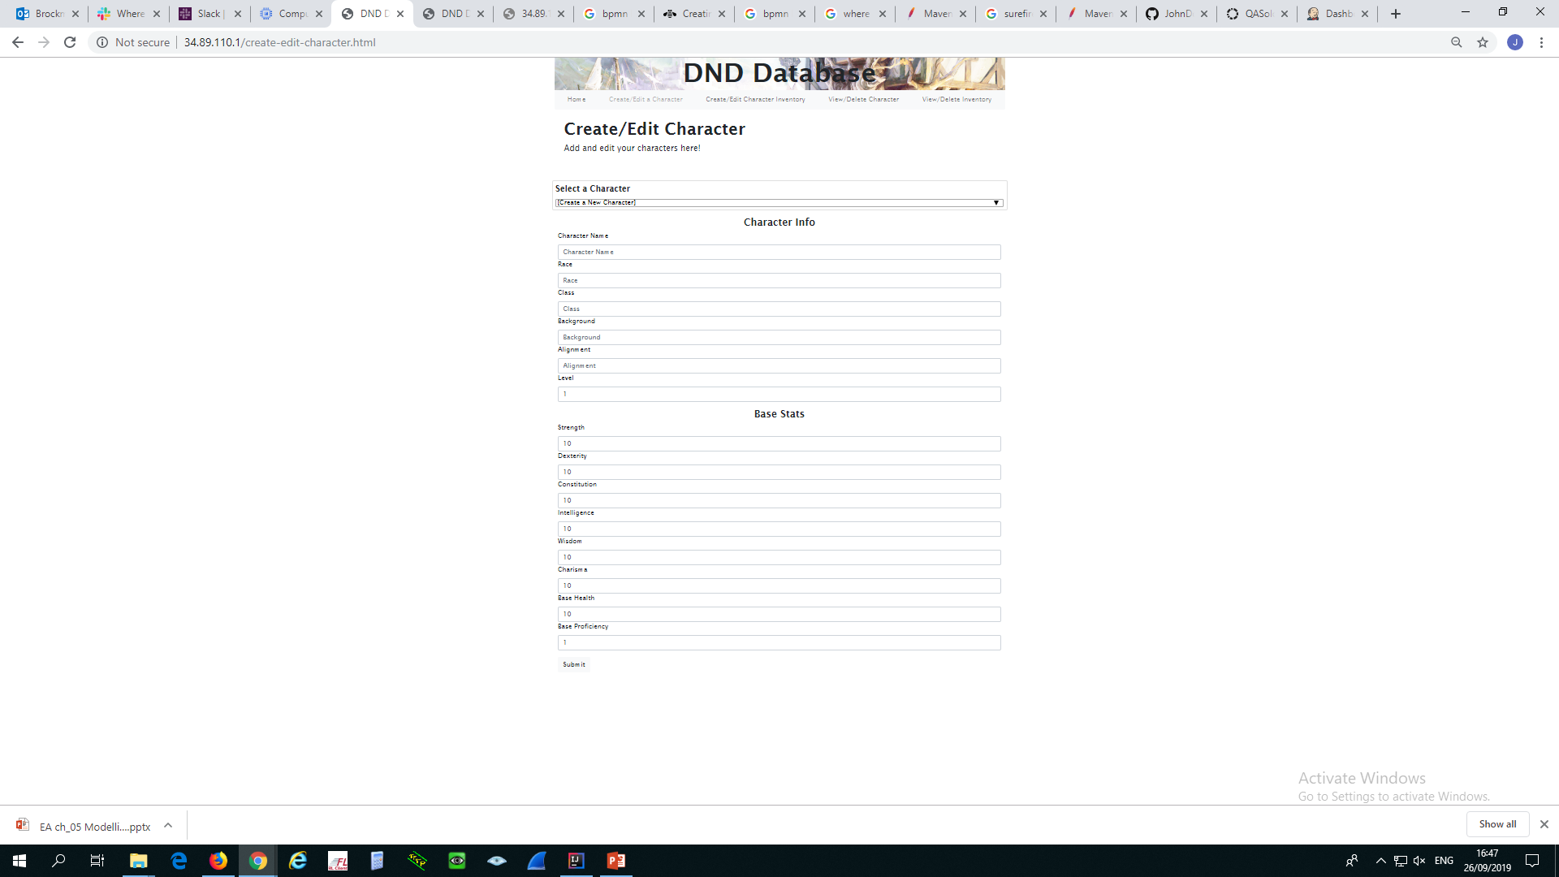
Front End - HTML, CSS, Bootstrap, JavaScript

Slide 15
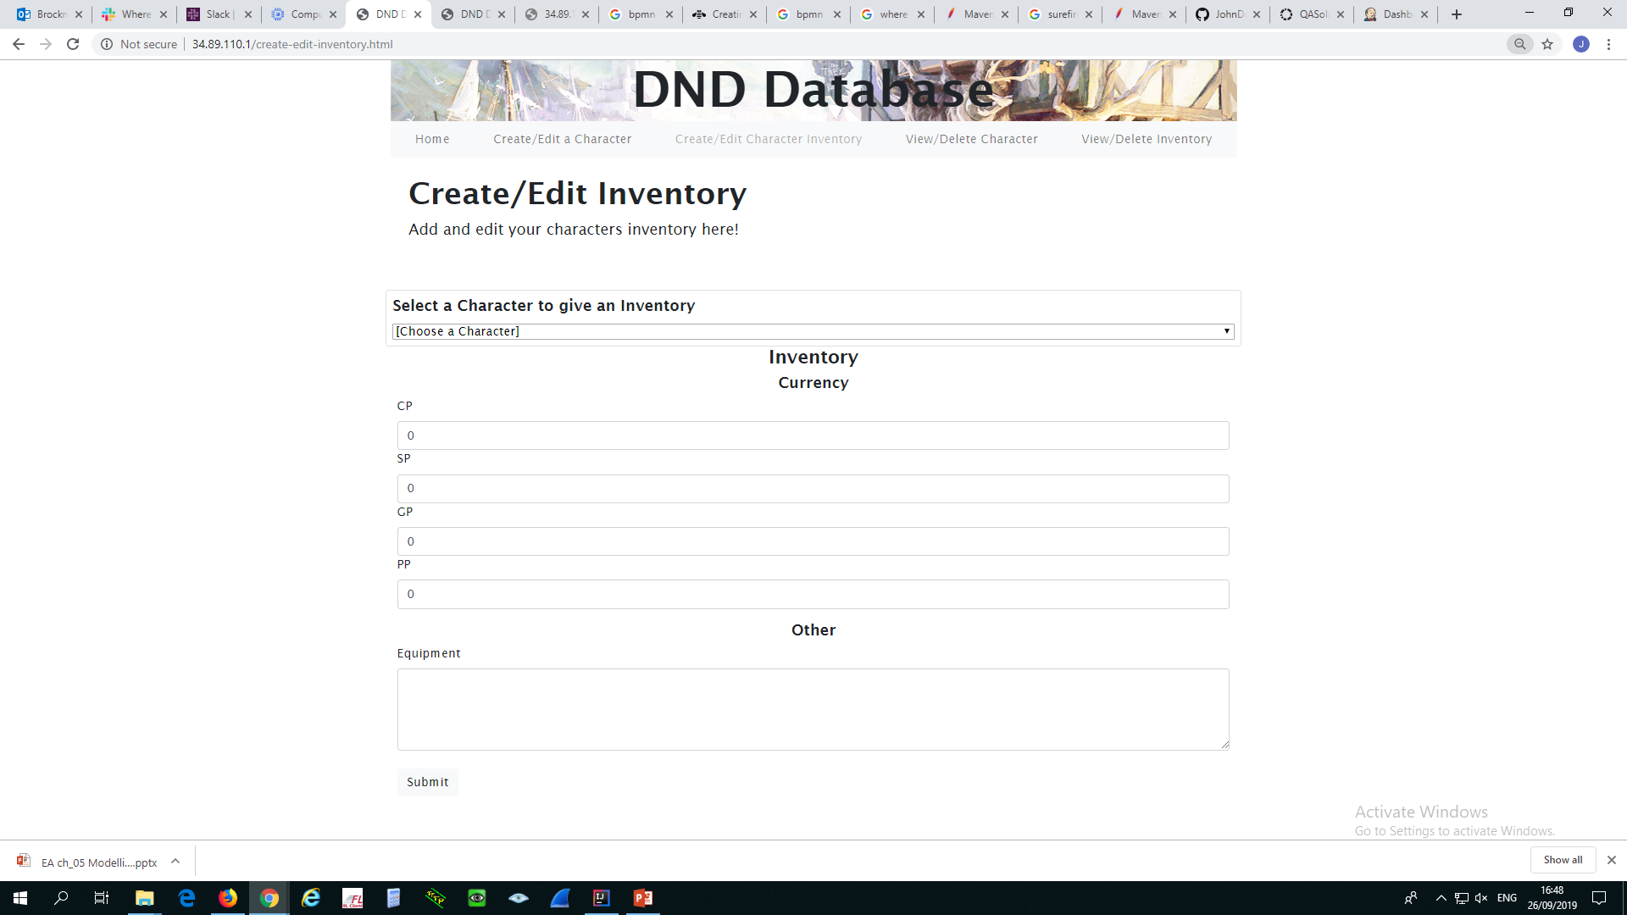
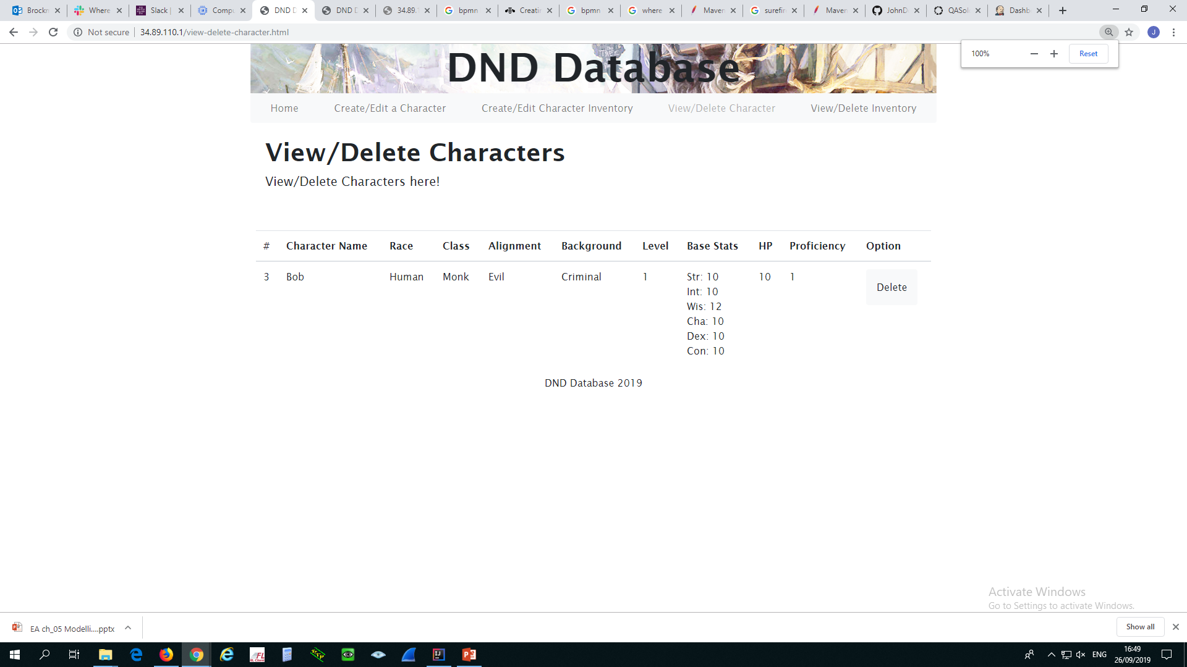
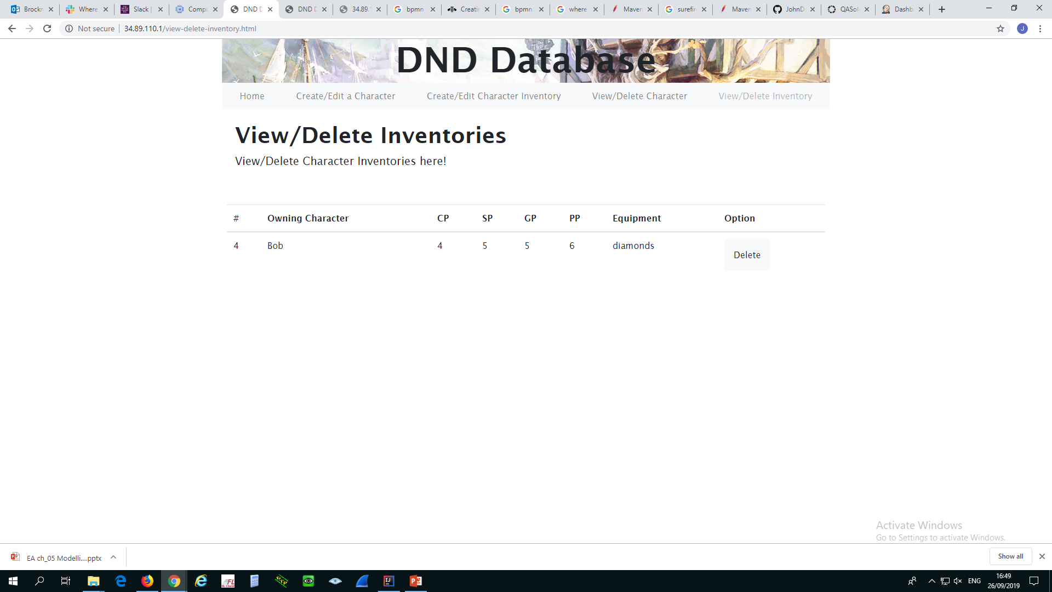
Front End - HTML, CSS, Bootstrap, JavaScript

Slide 16
Technologies
H2 Database Engine - Database
Java - Logic
Front-end - HTML, CSS, JavaScript
Backend API - Spring-Boot
Jenkins - CI Server
Maven - Dependency Management
Surefire - Test Reporting
Codacy - Code Quality Checking
Git - VCS Project Front End, Project Back End
Trello - Project Tracking
GCP - Live Environment

Slide 17
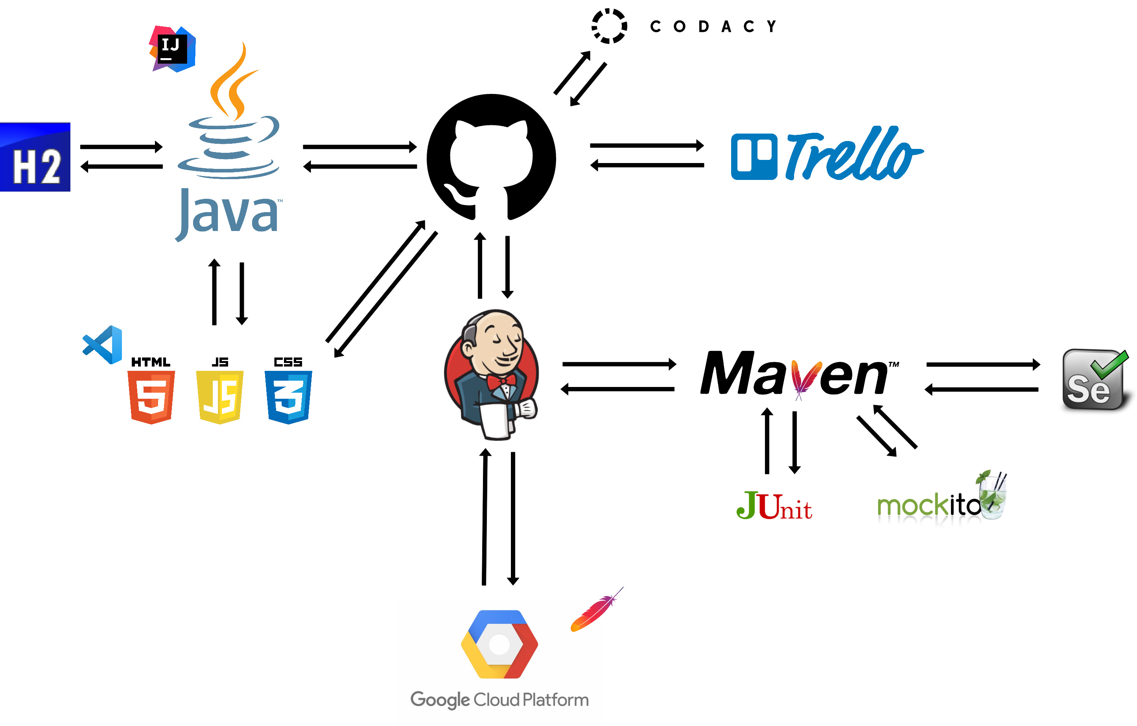
DevOps and Continuous Integration

Slide 18
Summary
What went well
Database and CRUD functionality
UX
Test Coverage
Code Quality Checking
Front End Testing
Use of CI Tools
Future Improvements
UX
Bootstrap (Modals, General Appearance)
Front End code could be cleaner
More Relational Databases:
- Items, Classes, Proficiencies

Slide 19
Demonstration
http://34.89.110.1/

Slide 20
Questions?

